Slide 1
Data Management MIS 6326.001 Professor Vivek Arora Group 7: Yifan Cao Ravi Dawar Wei Feng Rutwika Mohanty Chirag Sharma

Slide 2
PayTM

Slide 3
Contents
Introduction
PayTM Entity Relationship Diagram
PayTM Entity Relationship Diagram with Added Feature
Tables
Scenarios

Slide 4
Introduction
PayTM is one of the most popular mobile applications in India and has revolutionized the e-commerce industry by taking it a step further. Rivalling the likes of Amazon and Flipkart, PayTM has also emerged to be one of the biggest financial players in the industry.
PayTM is designed to be multi-dimensional. It contains various products for the users to choose from. Shopping, Travelling, paying off utility bills, prepaid mobile recharge, etc. are among some of the services that is provided by the application.
In this project, we will be covering four major aspects of the PayTM application. These aspects include the following elements:
Shopping.
Payments/Banking.
Travelling.
Booking Events.

Slide 5
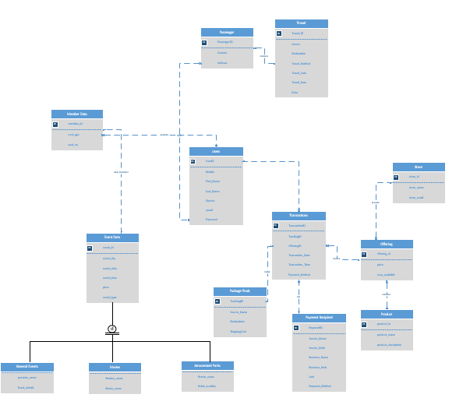
PayTM Entity Relationship Diagram

Slide 6
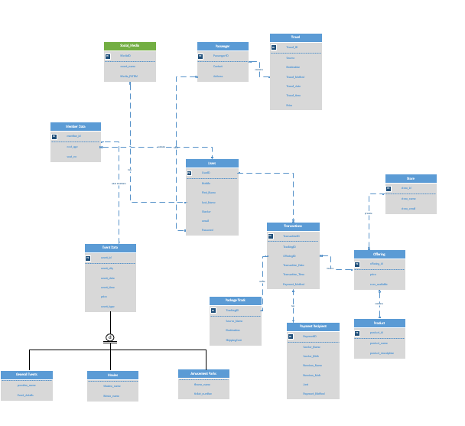
PayTM Enitity Relationship Diagram With Added Feature

Slide 7
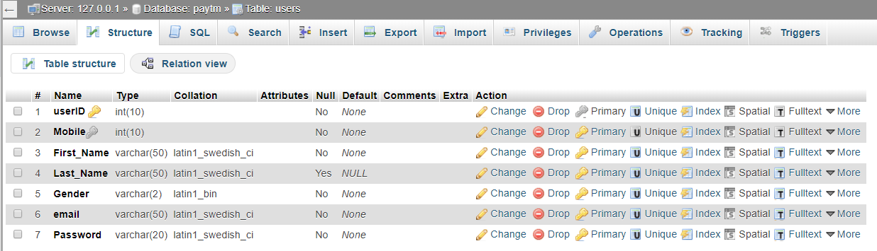
TABLES
Table Name: Users
The shopping section includes a universal ‘User’ class. The primary purpose of the ‘User’ class will be to maintain data of all the users in the system and fetch the details wherever required.
Primary Key: User ID
Attributes: Mobile |First_Name |Last_Name |Gender|Email|Password

Slide 8
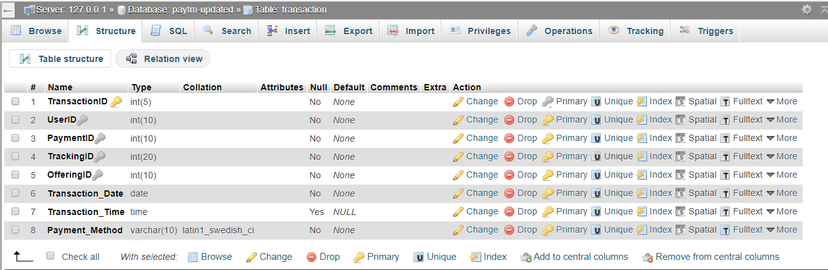
TABLES
Table Name: Transactions
‘Transaction’ class has Transaction ID as a primary key, with other attributes being Transaction amount, transaction date, transaction time and payment method. The primary purpose of the ‘Transaction’ class is to maintain data about the transactions performed by user.
Primary Key: TransactionID
Attributes: Tracking ID|Offering ID|Transaction_Date|Transaction_Time|Payment_Method

Slide 9
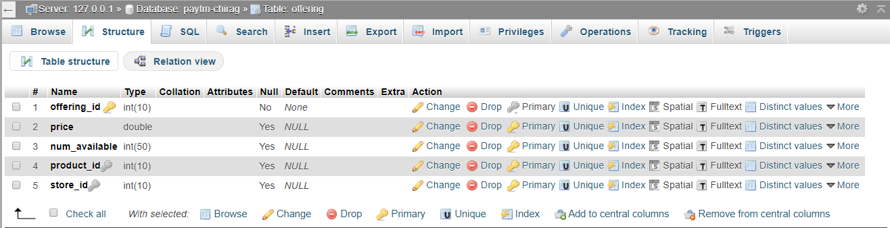
TABLES
Table Name: Offering
‘Offering’ includes a unique offering ID, price and number of available items. The primary purpose of the ‘Offering’ class is to infer the product availability in quantity and price of the product. It also helps in determining stores that provide these products.
Primary Key: offering ID
Attributes: price | num_available

Slide 10
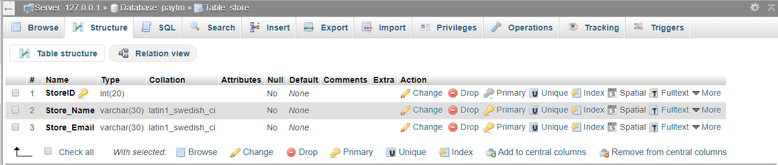
TABLES
Table Name: Store
The purpose of this class is to maintain a list of vendors that can be searched throughout the database.
Primary Key: store ID
Attributes: store_name |store_email

Slide 11
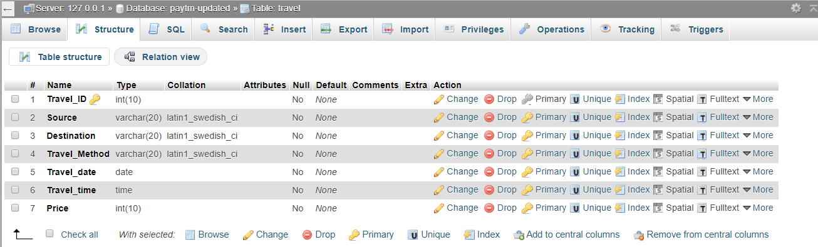
TABLES
Table Name: Travel
The purpose of this class is to maintain details of the travel, travel method that can be flight, bus or train and ticket price of the travel made by the user.
Primary Key: Travel_ID
Attributes: Source location |Destination Location |Travel Method |Date |Time |Price

Slide 12
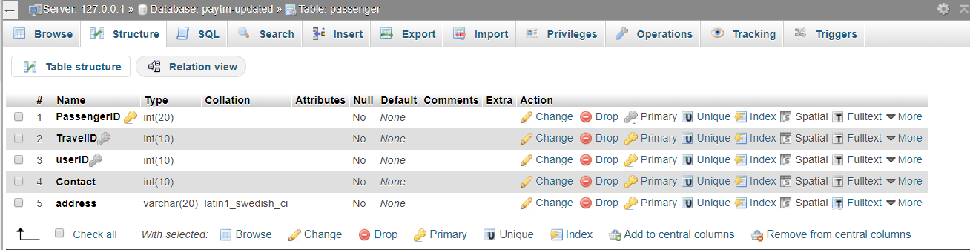
TABLES
Table Name: Passenger
This class keeps track of all the passengers that are going to be travelling from source to destination. This class is also important as it can identify each passenger and link them to their government issued ID. A user can have multiple passengers and a passenger can only be associated to one user.
Primary Key: Passenger ID
Attributes: Contact|Address

Slide 13
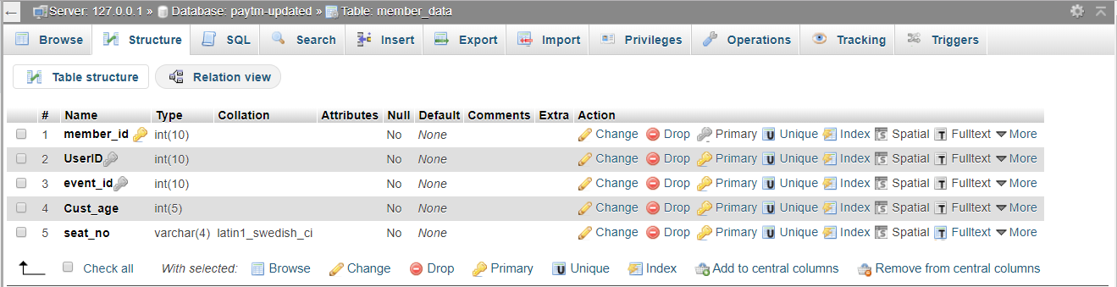
TABLES
Table Name: Member Data
This class keeps track of all the members that are going to the desired event. This class is also important, as it can identify each member and link them to their government issued ID. A user can have multiple members and a member can only be associated to one user.
Primary Key: member_id
Attributes: Cust_age |seat_no

Slide 14
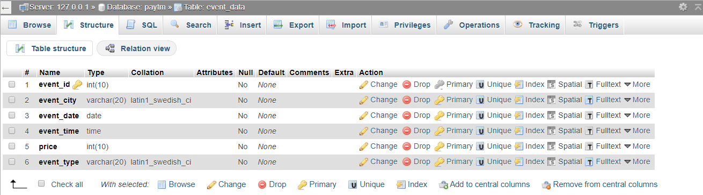
TABLES
Table Name: Event Data
The purpose of this class is to maintain details of the event, event type that can be general events, movies or amusement parks as well as the ticket price of the event.
‘Event Data’ will be a parent class and will consist of four different sub-classes or child classes:
Primary Key: event_id
Attributes: event_city |event_date |event_time |price |event_type

Slide 15
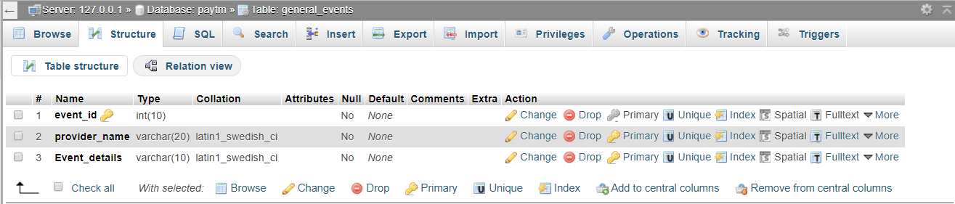
TABLES
Table Name: General Events
‘General Events’ is a child class of ‘Event data’. The purpose of this class is to maintain details of the general events.
Attributes: Provider_name | Event_details

Slide 16
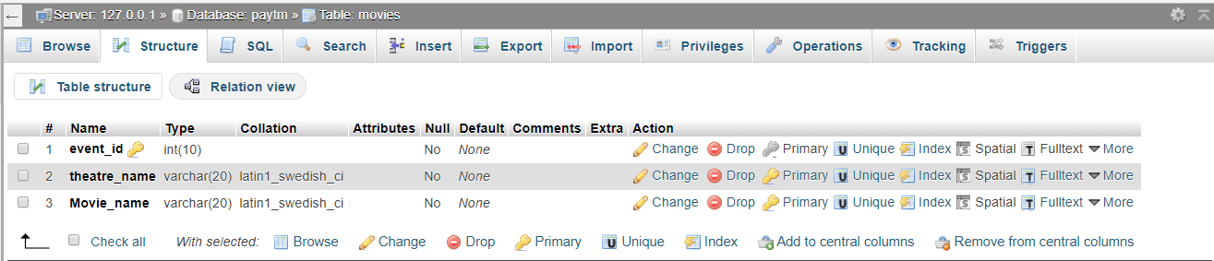
TABLES
Table Name: Movies
‘Movies’ is a child class of ‘Event data’. The purpose of this class is to maintain details of the movies for which user can book tickets.
Attributes: Theatre_name | Movie_name

Slide 17
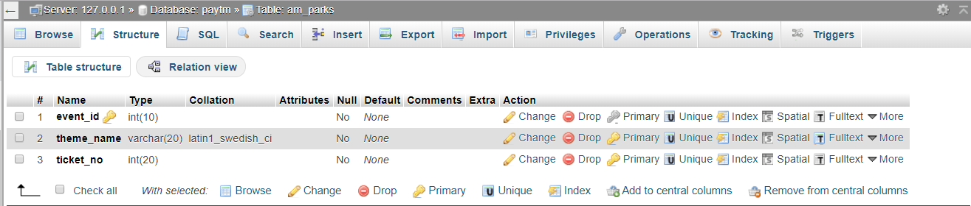
TABLES
Table Name: Amusement Parks
‘Amusement Parks’ is a child class of ‘Event data’. The purpose of this class is to maintain details of the amusement parks.
Attributes: Theme_name

Slide 18
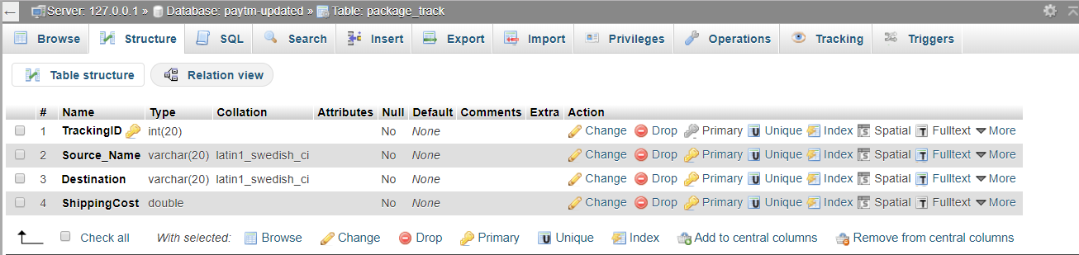
TABLES
Table Name: Package_Track
‘Package Track’ is created to keep track of all the order shipments that have been initiated by the user.
Primary Key: TrackingID
Attributes: Source_name|destination |ShippingCost

Slide 19
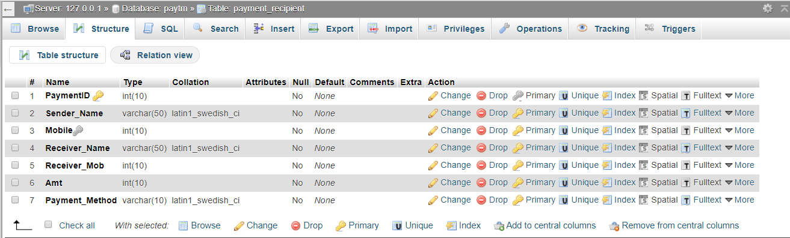
TABLES
Table Name: Payment Recipient
‘Payment Recipient’ class keeps track of the senders, receivers and the amount that is being transferred from one node to another, so that it can be used as a payment log and can be fetched by either party as per their requirements. A user can send money to multiple recipients.
Primary Key: PaymentID
Attributes: Sender_Name | Sender_Mob | Receiver_Name | Receiver_Mob | Amt | Payment_Method

Slide 20
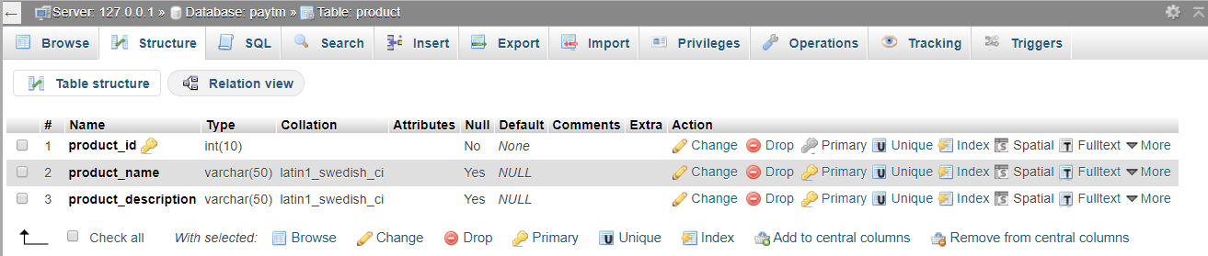
TABLES
Table Name: Product
This class catalogues the products that are being sold by the sellers listed in the PayTM application. A store can have many products, but a product can only be associated to one store.
Primary Key: product_id
Attributes: Product_name | Product_description

Slide 21
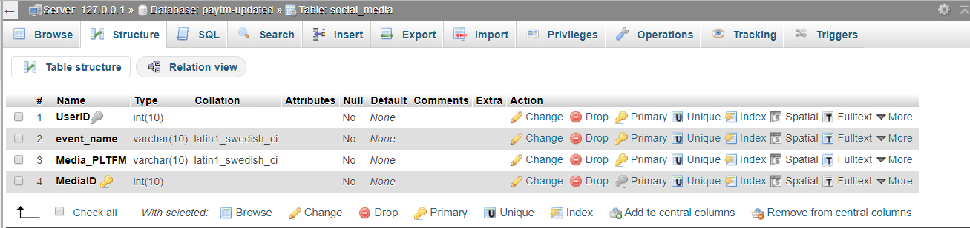
TABLES
Table Name: Social Media
This class keeps a track of the users and the events that they have shared on social media.
Primary Key: MediaID
Attributes: event_name |Media_PPPLTFM

Slide 22
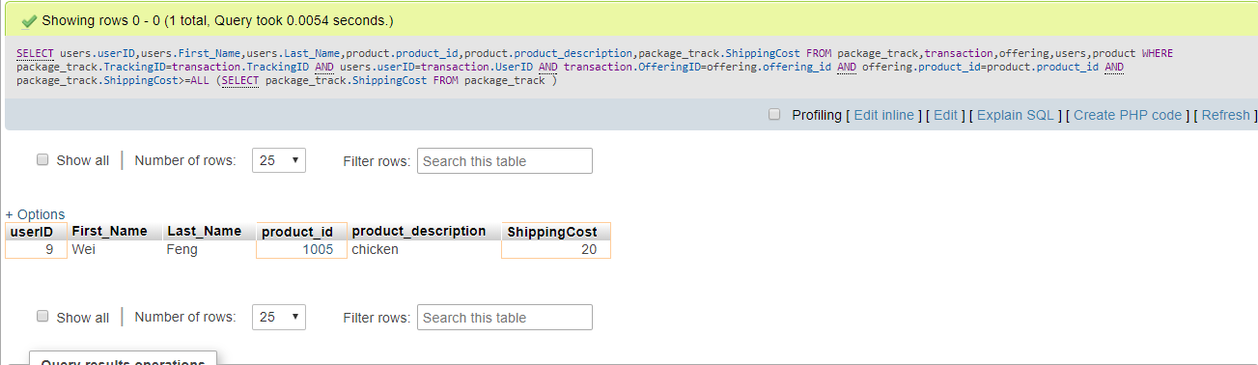
SCENARIOS
SCENARIO 1
Which user has the max shipping cost and for what product item?
SELECT users.userID,users.First_Name,users.Last_Name,product.product_id,product.product_description,package_track.ShippingCost
FROM package_track,transaction,offering,users,product
WHERE package_track.TrackingID=transaction.TrackingID AND users.userID=transaction.UserID AND transaction.OfferingID=offering.offering_id AND offering.product_id=product.product_id
AND package_track.ShippingCost>=ALL
(SELECT package_track.ShippingCost
FROM package_track
)

Slide 23
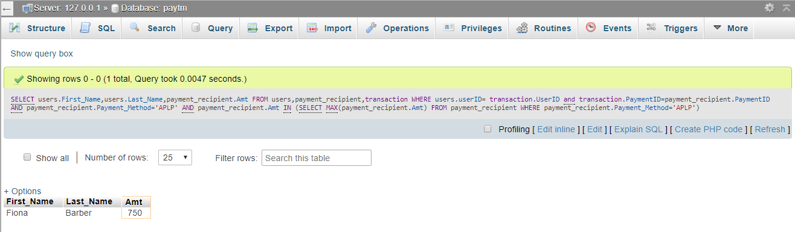
SCENARIOS
SCENARIO 2
Name of users and the maximum amount that used Apple Pay to send money to other user?
SELECT users.First_Name,users.Last_Name,payment_recipient.Amt FROM users,payment_recipient,transaction WHERE users.userID= transaction.UserID and transaction.PaymentID=payment_recipient.PaymentID AND payment_recipient.Payment_Method='APLP' AND payment_recipient.Amt IN
(SELECT MAX(payment_recipient.Amt)
FROM payment_recipient
WHERE payment_recipient.Payment_Method='APLP')

Slide 24
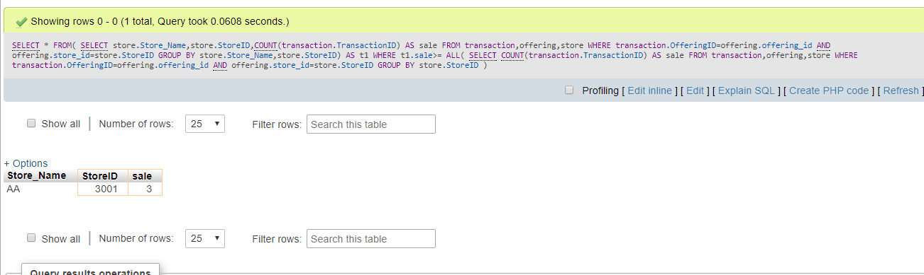
SCENARIO
SCENARIO 3
Which stores sell the most products?
SELECT * FROM( SELECT store.Store_Name,store.StoreID,COUNT(transaction.TransactionID) AS sale
FROM transaction,offering,store
WHERE transaction.OfferingID=offering.offering_id AND offering.store_id=store.StoreID
GROUP BY store.Store_Name,store.StoreID) AS t1
WHERE t1.sale>= ALL(
SELECT COUNT(transaction.TransactionID) AS sale
FROM transaction,offering,store
WHERE transaction.OfferingID=offering.offering_id AND offering.store_id=store.StoreID
GROUP BY store.StoreID
)

Slide 25
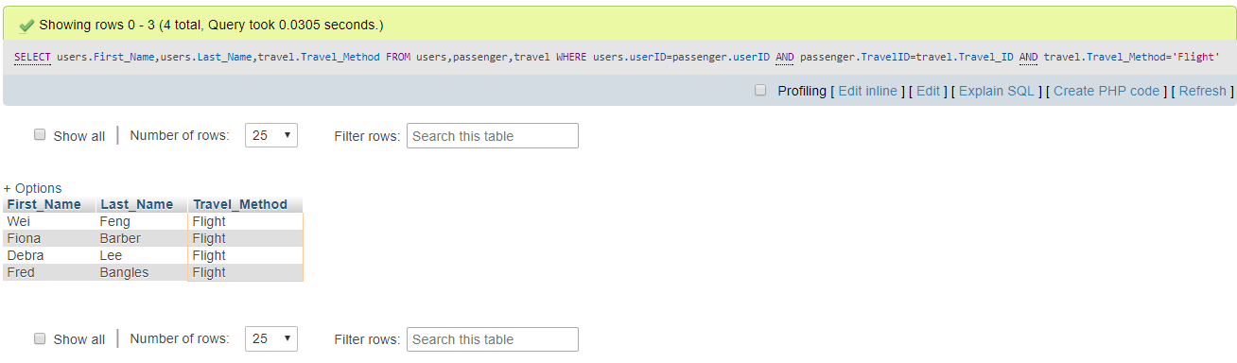
SCENARIOS
SCENARIO 4
Which user used flight to travel?
SELECT users.First_Name,users.Last_Name,travel.Travel_Method
FROM users,passenger,travel
WHERE users.userID=passenger.userID AND passenger.TravelID=travel.Travel_ID AND travel.Travel_Method='Flight'

Slide 26
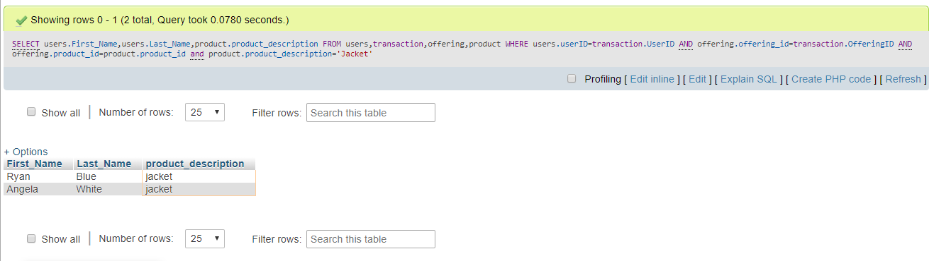
SCENARIOS
SCENARIO 5
Which user bought Jackets?
SELECT users.First_Name,users.Last_Name,product.product_description
FROM users,transaction,offering,product
WHERE users.userID=transaction.UserID AND offering.offering_id=transaction.OfferingID AND offering.product_id=product.product_id and product.product_description='Jacket'

Slide 27
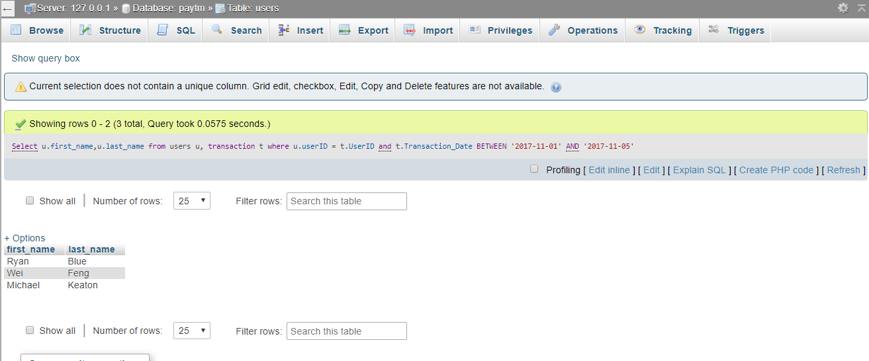
SCENARIOS
SCENARIO 6
Name of the users who made transactions between a specific date?
Select u.first_name,u.last_name from users u, transaction t where u.userID = t.UserID and t.Transaction_Date BETWEEN '2017-11-01' AND '2017-11-05'

Slide 28
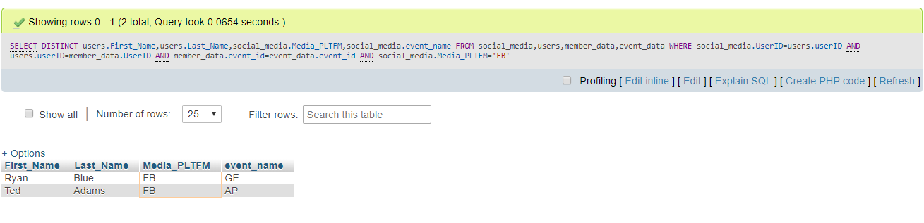
SCENARIOS
SCENARIO 7
Name of the users who used FB to broadcast their events?
SELECT DISTINCT users.First_Name,users.Last_Name,social_media.Media_PLTFM,social_media.event_name
FROM social_media,users,member_data,event_data
WHERE social_media.UserID=users.userID AND users.userID=member_data.UserID AND member_data.event_id=event_data.event_id
AND social_media.Media_PLTFM='FB'

Slide 29
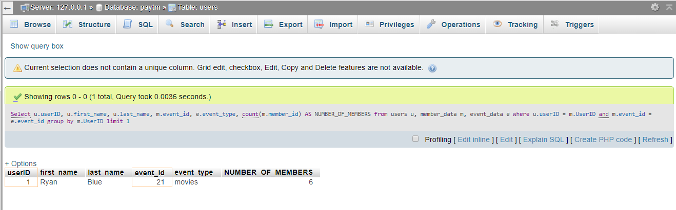
SCENARIOS
SCENARIO 8
Max Number of members associated to a user going to a specific event?
Select u.userID, u.first_name, u.last_name, m.event_id, e.event_type, count(m.member_id) AS NUMBER_OF_MEMBERS from users u, member_data m, event_data e where u.userID = m.UserID and m.event_id = e.event_id group by m.UserID limit 1

Slide 30
Questions?

